Slide 1
Bayesian Analysis of Glucose Data using Gibbs sampling and JAGS:
A Two Component Normal Mixture Model
MA 5770 - Bayesian Statistics - By Kui Zhang
Project Report

Slide 2
Table of contents
01
02
03
04
05
06
Introduction
Statistical Analysis
Bayesian
Methodology
Gibbs Sampler
MCMC Diagnostic
JAGS sampling
MCMC Diagnostic
Model checking
Summary Statistics

Slide 3
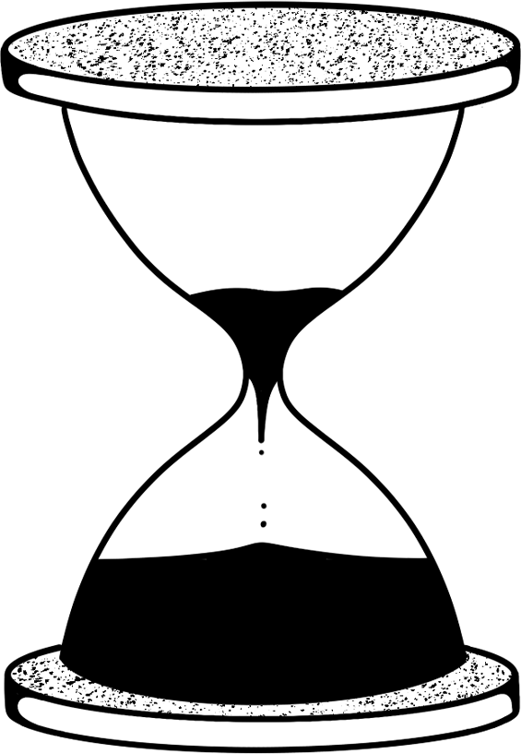
Team
Xiaolin Liu
Prateek Singh
Xinyun Liu
Manoj Kumar Surabhi

Slide 4
01
Introduction

Slide 5
Introduction
The study analyzes plasma glucose levels from 532 females living near Phoenix, Arizona, who were tested for diabetes.
The goal is to use a Bayesian approach with a mixture of normal distributions, each with different means and variances, to capture the data's skewness and outliers, where a single normal distribution may not adequately represent the data.
The project investigates the application of Bayesian statistical methods within a simulated framework.
Our aim is to implement a Gibbs sampler, using both
Manual approach
Automated (JAGS) approach
Evaluate the performance of each model using MCMC diagnostics.

Slide 6
Statistical Analysis
02

Slide 7
Analysis of data
The distribution of glucose levels are observed via histogram
Measure of central tendencies and variances are calculated
A Bayesian mixture model approximates the data distribution using a mixture of two normal models.
The Gibbs and JAGS samples are used to obtain samples to approximate the posterior distribution of the data.
The analysis is performed using R Studio software and the JAGS software package.

Slide 8
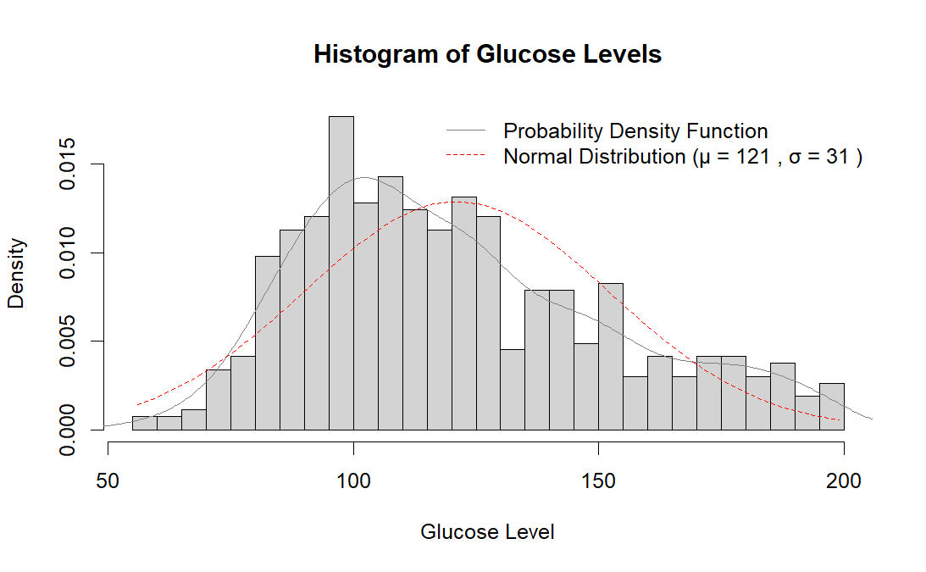
Visualization of Glucose levels
The plot shows histogram, kernel density estimation and normal based on following measure of central tendencies and dispersion:
Sample Mean: 121.0
Sample Median: 115.0
Sample Mode: 100.0
Sample Variance: 961.0
Standard Deviation: 31.0
It can be seen that the data is rightly skewed with with a longer tail for higher glucose values.

Slide 9
So, Would a Bayesian mixture normal model be more appropriate?
Based on the histogram of Glucose levels, a normal model may not fully capture the data's characteristics.
?

Slide 10
Bayesian Methodology
03

Slide 11
Sampling and Priors
The mixture model is used to classify observation into two groups using latent variable (x_{i}), a mixing proportion (𝜋), and group specific parameters (𝜃₁, 𝜃₂, 𝜎₁², σ₂²).
Sampling Distribution:
y_{i} | x_{i} = dnorm(y_{i}; 𝜃_{k}, 𝜎_{k}²), k ∊ {1, 2}
The latent group membership x_{i} follows P(X_{i} = 1) = 𝜋, P(X_{i} = 2) = (1 - 𝜋)
Prior Distribution:
Mixing pro𝑝ortions: p(𝜋) = 𝑑𝑏𝑒𝑡𝑎(𝜋; 𝛼, 𝛽)
Group means (𝜃₁, 𝜃₂): 𝑝(𝜃_{k}) = 𝑛𝑜𝑟𝑚𝑎𝑙(𝜃_{k}; 𝜇_{o}, 𝜏₀²), k ∊ {1, 2}
Group Variance 𝑝(𝜎_{k}²) = 𝑖𝑛𝑣𝑒𝑟𝑠𝑒-𝑔𝑎𝑚𝑚𝑎(𝜎_{k}²; 𝜈₀/2, 𝜈_{o}𝜎₀²/2)

Slide 12
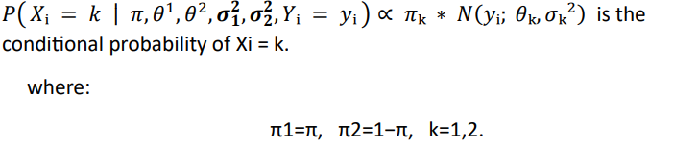
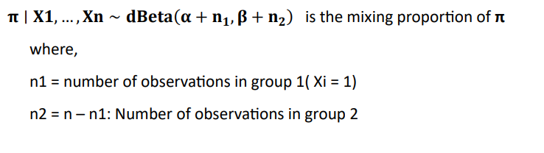
Full Conditional distributions

Slide 13
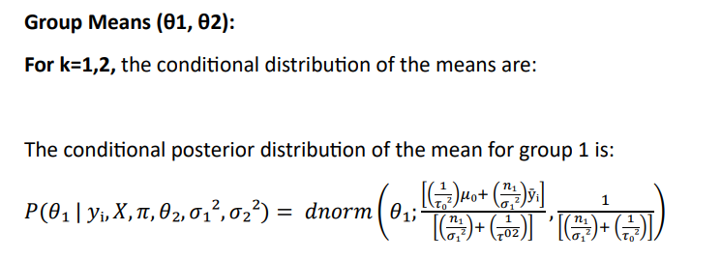
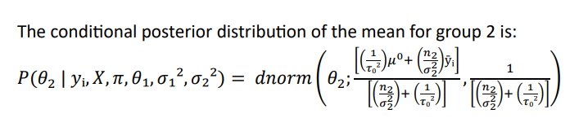

Slide 14
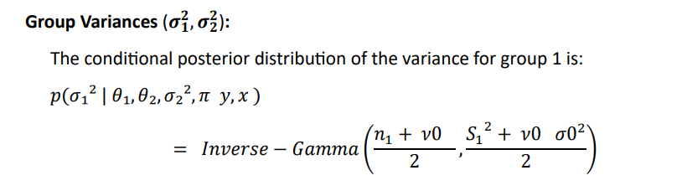
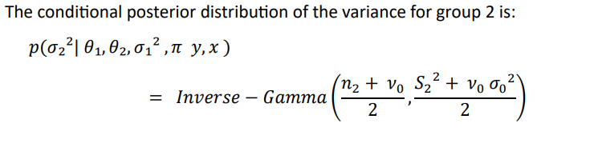

Slide 15
Gibbs Sampler
MCMC Diagnostic
04

Slide 16
Gibbs Samples:
𝜃(1)(𝑠) Diagnostic:
𝜃(2)(𝑠) Diagnostic:
5000
With initial latent variable (x_{i}) = 1 if y_{i} is < median, else 2
Running diagnostic for - 𝜃(1)(𝑠) = min {𝜃1(𝑠) , 𝜃2(𝑠)}
Samples diagnosed for two equal halves of 2500
With initial latent variable (x_{i}) = 1 with probability 0.5, else 2
Running diagnostic for - 𝜃(2)(𝑠) = max {𝜃1(𝑠) , 𝜃2(𝑠)}.
Samples diagnosed for two different chains.

Slide 17
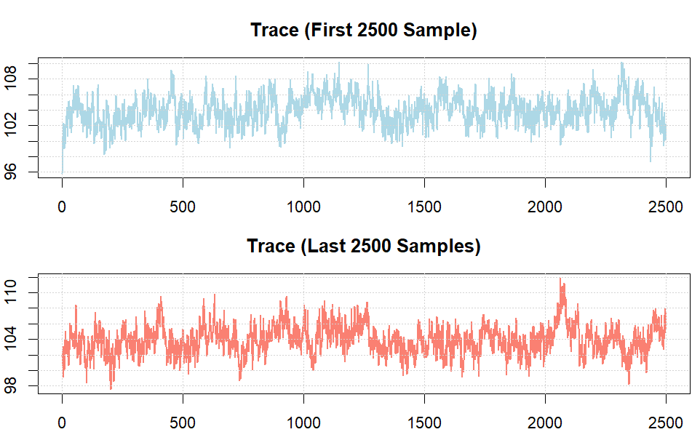
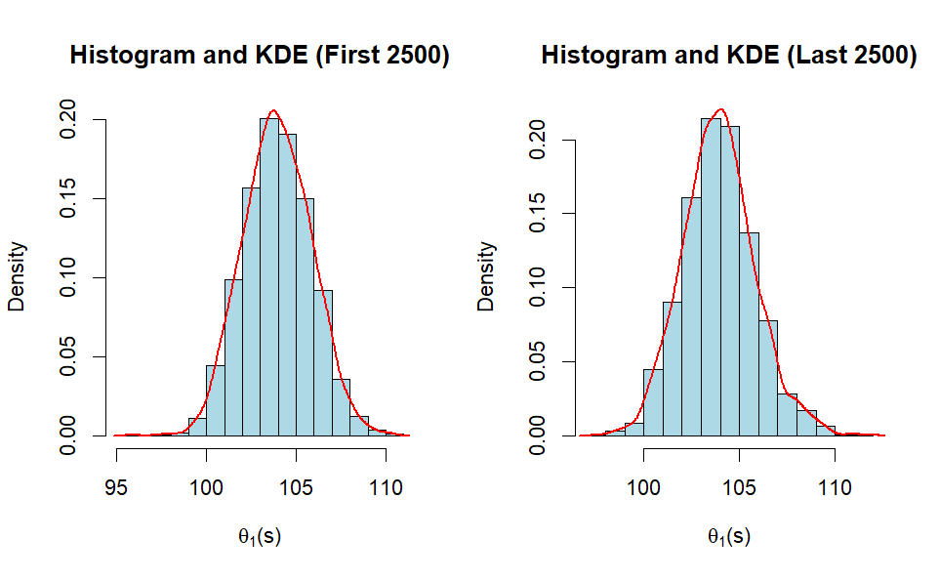
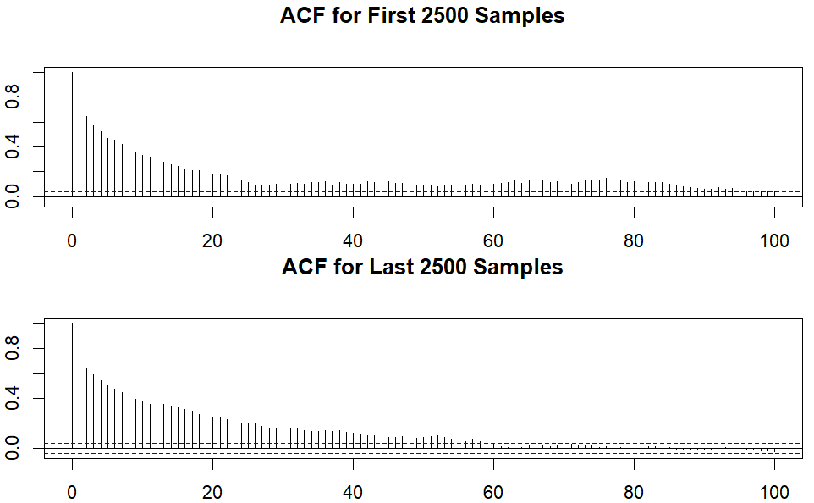
Sample Split - 𝜃(1)(𝑠)
First 2500 Samples
𝜃1: 104.0
95% CI: [100.4, 107.7]
ACF: 0.1628 (Lag 100)
ESS: 134
Last 2500 Samples
𝜃1: 103.9
95% CI: [100.4, 108.0]
ACF: 0.1419 (Lag 100)
ESS : 94

Slide 18
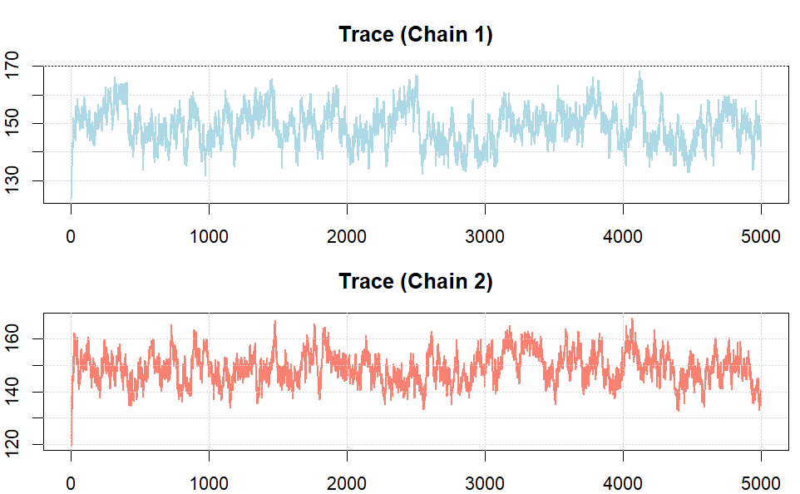
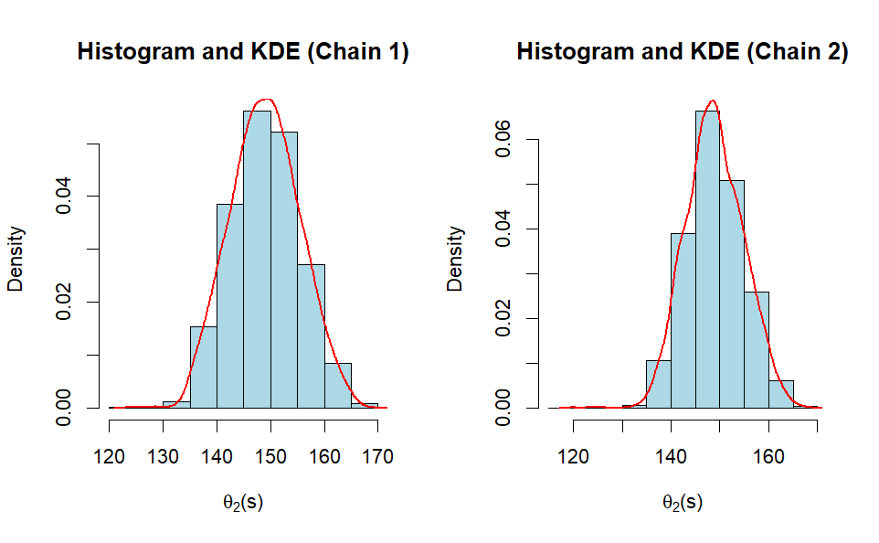
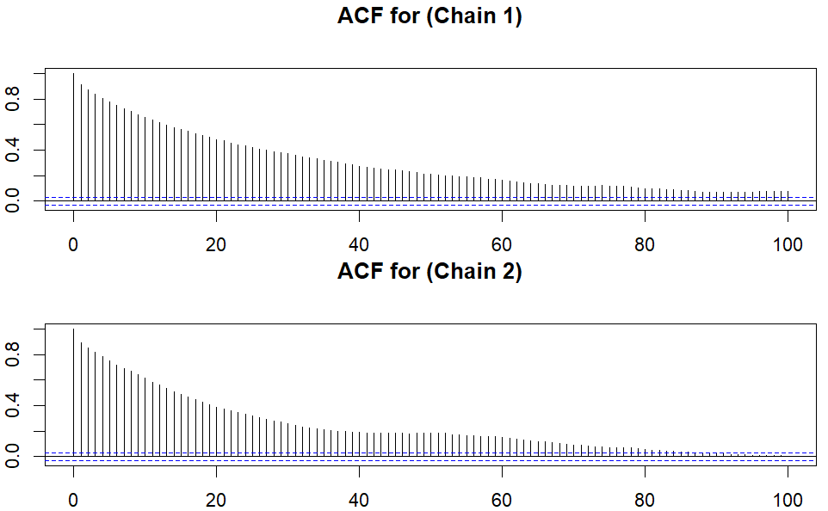
Multiple Chains- 𝜃(1)(𝑠)
Chain 1
𝜃2: 149.0
95% CI: [136.8, 161.7]
ACF: 0.2958 (Lag 100)
ESS: 98
Chain 2
𝜃2: 149.0
95% CI: [138.0, 160.5]
ACF: 0.2414 (Lag 100)
ESS : 18

Slide 19
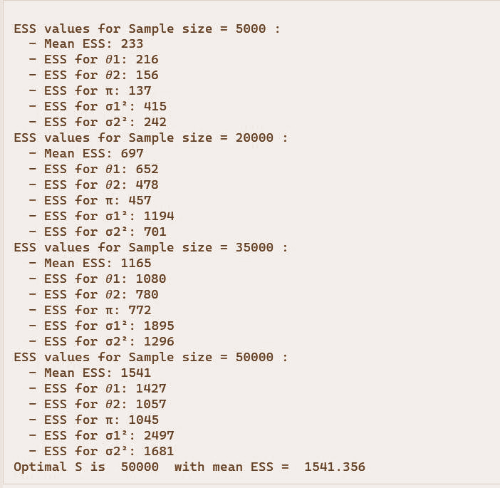
Simulating 1,000 samples
ESS for π: 1045
ESS for 𝜃1: 1427
ESS for 𝜃2: 1057
ESS for 𝜎12: 2497
ESS for 𝜎22: 1681
Optimal S is 50, 000 samples having mean ESS = 1541

Slide 20
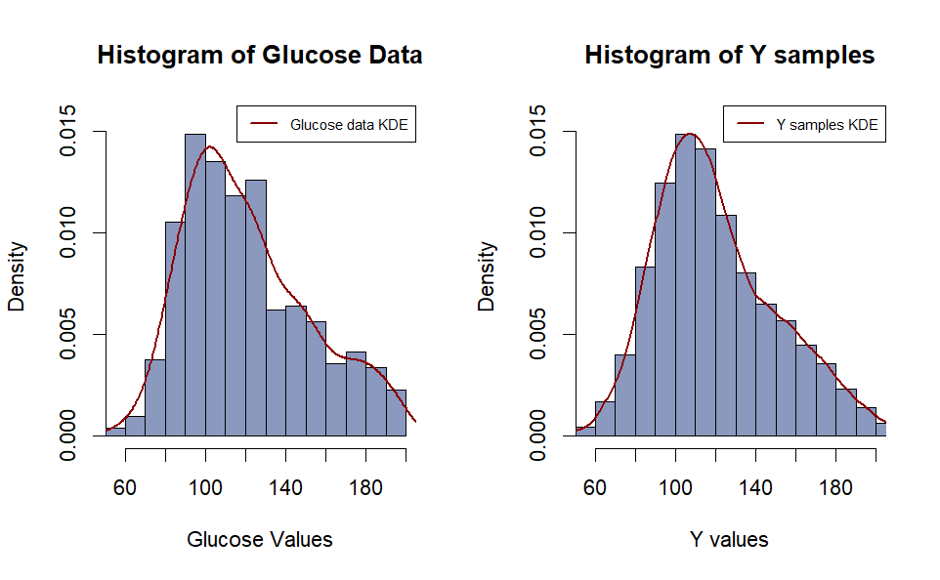
Posterior Distribution
Simulated distribution of 50,000 Gibbs samples generated to replicate 1,000 data samples.

Slide 21
JAGS Sampler
MCMC Diagnostic
05

Slide 22
JAGS Model File
model {
for (i in 1:n) {
X[i] ~ dcat(c(pi, 1 - pi))
y[i] ~ dnorm(
ifelse(X[i] == 1, theta1, theta2),
ifelse(X[i] == 1, 1 / s21, 1 / s22))
}
pi ~ dbeta(alpha, beta)
theta1 ~ dnorm(mu0, 1 / s21)
theta2 ~ dnorm(mu0, 1 / s22)
tau1 ~ dgamma(v0/2, v0 * s20 / 2)
tau2 ~ dgamma(v0/2, v0 * s20 / 2)
s21 <- 1 / tau1
s22 <- 1 / tau2
}

Slide 23
JAGS Sampler:
With initial latent variable (x_{i}) = 1 if y_{i} is < median, else 2
Performing analysis for 𝜃(1)(𝑠) = min {𝜃1(𝑠) , 𝜃2(𝑠)} and 𝜃(2)(𝑠) = max {𝜃1(𝑠) , 𝜃2(𝑠)}
Sample size = 50,000
Thinning value = 1
Burnin in = 0
No of chains = 1

Slide 24
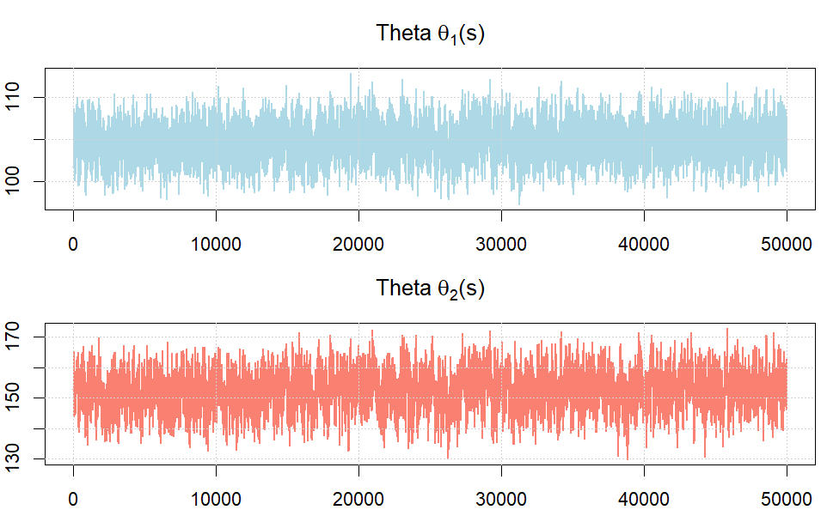
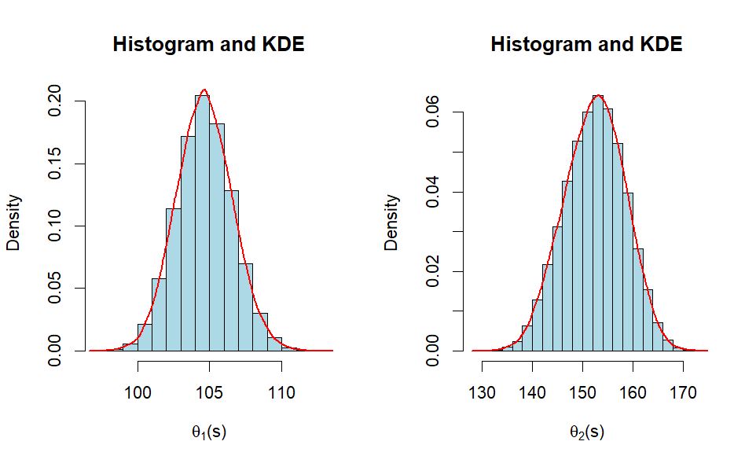
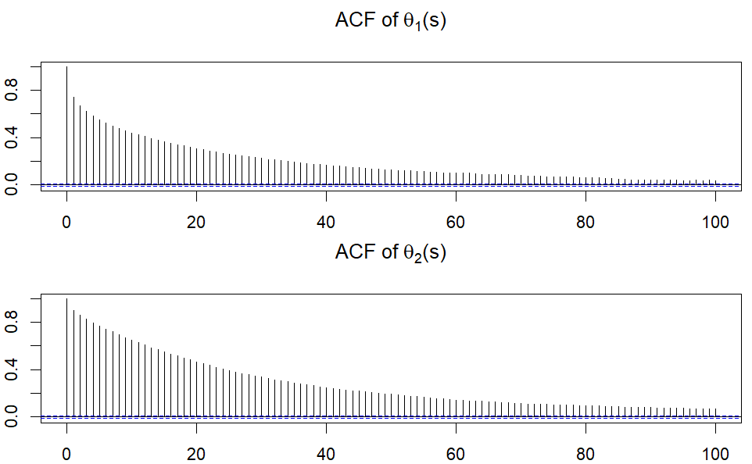
𝜃(1)(𝑠) and 𝜃(1)(𝑠)
𝜃(1)(𝑠)
𝜃1 Mean : 104.7
95% CI: [100.9, 108.6]
ACF: 0.1767 (Lag 100)
ESS: 1453
𝜃(1)(𝑠)
𝜃2 Mean: 152.6
95% CI: [140.5, 163.6]
ACF: 0.2566 (Lag 100)
ESS : 969

Slide 25
Model Checking
Summary Statistics
06

Slide 26
Model Checking
The KDE of glucose data is skewed with peak shifted towards lower glucose values, with a tail towards higher glucose values and slight second peak towards those higher glucose values.
The KDE of sampled Y values from Gibbs sampler follows a similar pattern with slight minor differences around peak and tail ends.
Both histograms and KDE have a similar shape, which suggest Gibbs sampler effectively captures our data.
Alternatively we can use JAGS to further confirm the results obtained from Gibbs
Hence, the two-component model is reasonably good to capture overall shape and spread of our glucose data distribution and is reliable choice to model our data.

Slide 27
Summary Statistics
Theta | Method | Mean | 95% CI | ACF (Lag 100) | ESS (S=...)
𝜃(1)(𝑠) | Gibbs (First Half) | 104.0 | [100.4, 107.7] | 0.1628 | 134 (S=2,500)
 | Gibbs (Last Half) | 104.0 | [100.4, 108.0] | 0.1419 | 94 (S=2,500)
 | JAGS | 104.7 | [100.9, 108.6] | 0.1767 | 1453 (S=50,000)
𝜃(1)(𝑠) | Gibbs (Chain 1) | 149.0 | [136.8, 161.7] | 0.2958 | 98 (S=5,000)
 | Gibbs (Chain 2) | 149.0 | [138.0, 160.5] | 0.2414 | 118 (S=5,000)
 | JAGS | 152.6 | [140.5, 163.6] | 0.2566 | 969 (S=50,000)

Slide 28
̴
Conclusion

Slide 29
The Gibbs sampler converges effectively, although with some limitations like in ESS and autocorrelation
The JAGS results on the other hand gives better results with narrower 95% CI, higher effective sample sizes and low autocorrelation, indicating a lot better mixing and convergence. This is understandable as JAGS internal convergence function are lot more optimized that Gibbs
So, in conclusion the two-component mixture model fits the glucose data reasonably well, capturing key features of the distribution and is more appropriate to be model data over a single normal model

Slide 30
Thank You
Please, Feel free to ask any questions
?

